Slide 1
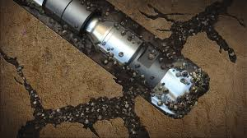
1
PRACTICAL APPROCHES FOR SOLVING LOST CIRCULATION PROBLEMS WHILE DRILLING
UNDER THE GUIDANCE OF
Mr. VIVEK THAMIZHMANI B.E, M.S,Petro.
TEAM
MEMBERS
S.SAKTHI DOSS
(17612913)
M.RAJKUMAR
(17612113)
Third Review
09/11/2020

Slide 2
2
FUNDAMENTALS OF LOST CIRCULATION CONTROL
Lost Circulation Materials (LCMs) Selection.
Borehole Stability Analysis
Management Of Equivalent Circulation Density
Conventional LCMs
Fractures And Fracture Identification
High Fluid Loss Squeezes
Machanics Of Fracturing
Dilatant Slurries
Precipitated Chemical Slurries
Chemically Activated Cross – Linked Pills
Cement Slurries

Slide 3
FUNDAMENTALS OF LOST CIRCULATION CONTROL A Lot Of Effort Has Been Done To Understand The Mechanics Of Lost Circulation Control. Lost Circulation Control During Well Construction Is More Than Just Selecting The Right Lost Circulation Material (LCM) But Requires A Complete Engineered Approach (Whitfill, 2008). Some Of The Approaches Involve Borehole Stability Analysis, Equivalent Circulating Density (ECD) Modelling , Leak-off Flow-path Geometry Considerations, Drilling Fluid And LCM Selection To Help Minimize Effects On ECD, On-site Monitoring Using Annular Pressure While Drilling (APWD), Connection Flow Monitoring Techniques, And Timely Application Of LCM And Treatments. This Chapter Sheds Light On The Physics And Chemistry Of Some Of The Lost Circulation Control Approaches.
3

Slide 4
LOST CIRCULATION MATERIALS (LCMs) SELECTION
LCMs are needed to stop fluid losses in order to drill ahead in most drilling operations. An LCM should react, block fractures, and form a bridge to provide a seal in a timely manner. The seal could be temporary or even permanent. Permanent seals are used to block thief zones in non-producing intervals while temporary seals are used to block loss zones in pay intervals (Fidan et al. 2004). Previous studies have demonstrated that some products work better than others as lost circulation materials (Sanders et al. 2010). LCMs are categorized into common groups along their physical and chemical characteristics. These groups are as follows (Onyekwere, 2002):
4
Conventional Lost Circulation Materials; (fibers, flakes, and granules)
High Fluid Loss Squeezes; (diatomaceous earth or clay blends)
Gunk Slurries; (diesel oil bentonite)
Precipitated Chemical Slurries; (silicate and latex)
Resin-coated Sand
Cross-linked Polymer Slurries
Cements
Barite Plugs
Dilatant Slurries

Slide 5
CONVENTIONAL LCMS
These LCMs Can Be Classified As Granular (Ground Walnut Shells, Pecan Shells, Almond Shells, Plastic, And Calcium Carbonate), Flakes (Ground Mica, Plastic Laminate, Cellophane, And Polyethylene Plastic Chips), Fibers (Rice Hulls, Peanut Hulls, Wood, Cane Etc.) Or A Mixture Of The Three. The Granular LCMs Form Two Types Of Bridges; One At The Formation Face And One Within The Formation Matrix.
5
The Latter Sealing Is Preferred Because It Forms A More Permanent Bridge Within The Formation Such That Pipe Movements In The Wellbore Cannot Dislodge The Granular Particles. The Effectiveness Of Granular LCMs Depends On Their Particle Size Distribution, With Larger Particles First Forming A Bridge Across Or Within The Void And Smaller Particles Bridging The Openings Between Larger Ones. Fibrous Materials Are Best Suited For Controlling Losses In Porous And Highly Permeable Formations Because They Form A Mat-like Bridge Over The Pore Openings. The Mat Reduces The Size Of The Openings To The Formation, Permitting The Colloidal Particles In The Mud To Rapidly Deposit A Filter Cake. Flake LCMs Are Also Designed To Form A Mat On The Formation Face, Which Also Provides The Best Results As Fibrous Materials When Used To Treat Losses In Porous And Highly Permeable Formations. Blends Of Granular, Flakes, And Fibrous Materials Are Used In Solving Actual Field Problems (Pilehvari And Nyshadham, 2002).

Slide 6
HIGH FLUID LOSS SQUEEZES
These LCMs Lose Water Quickly And Deposit A Thick Cake Of Residual Solids In The Loss Zone. This Method Is Particularly Useful For Preventing The Extension Of Natural Or Induced Fractures, As The Deposited Solids Prevent The Transmission Of Pressure To The Tip Of The Fractures. The Two Main High Fluid Loss Pills Are: 1) Diaseal M (Diatomaceous Earth) And 2) Attapulgite /Calcium Carbonate.
GUNK SLURRIES
The Gunk Slurries Consist Of Two Or More Fluids Which Upon Making Contact With The Wellbore Or The Loss Zone Form A Viscous Plug Which Seals The Zone. For Partial Losses, Better Results Are Achieved By Using Mud-diesel-oil- bentonite (M-DOB) Plugs. When This Mixture Contacts Water Or Water-based Mud, A Mass With High Gel Strength Is Formed. The DOB Mixture Is Pumped Down The Drill String While The Mud Is Pumped Down The Annulus. M-DOB Plugs Have Several Disadvantages .
6

Slide 7
PRECIPITATED CHEMICAL SLURRIES
Both Silicate Solutions And Commercial Latex Additives Used For Cementing Can Be Made To Precipitate And Used To Plug Loss Zones When Pumped In Combination With Calcium Chloride. The General Ideal Is To Pump A Calcium Chloride Pill Followed By The Silicate Of Latex Slurry. When These Two Slurries Mix In The Open Hole, Hopefully Adjacent To The Loss Zone, They Form A Viscous Plug Which Can Slow And Seal Many Loss Zones.
7
CHEMICALLY ACTIVATED CROSS-LINKED PILLS (CACP)
Cross-linking is the linking of two independent polymer chains by a grouping (crosslinking agents) that spans or links two chains. (Bruton et al. 2001). The advantage of these pills is that they can be used to stop losses in water, oil or synthetic-based drilling muds . However, their main limitation is that they are not biologically or chemically degradable in the wellbore and hence they must be used with caution near pay zones.
CEMENT SLURRIES
Special Cement Formulations Like Magnesium-based Cements And Thixotropic Cements Are More Common . Portland Cements Are Also Being Used As LCMs Only After Other Techniques Have Proven Unsuccessful, Or If Experience Has Shown It To Be The Method Of Choice . Portland Cement Compositions Have Particle Size Distributions In The 30 To 100 Micron Range; Which, For The Most Part, Should Not Penetrate The Permeability Matrix Near Producing Zones.

Slide 8
DILATANT SLURRIES
These LCMs Are Composed Of Specifically Sized Solids And Polymers That Are Both Water Soluble And Insoluble. An Example Is A Shear-thickening Fluid (STF) Which Was Developed By Exxon Production Research Company In 1983 (Hamburger Et Al. 1983).
The Ability Of These Types Of Fluids To Thicken Irreversibly When They Pass Through The High-shear Zones In The Drill Bit Make Them Suitable For Stopping Losses In Any Loss Zone.
8
Lost Circulation Can Be Boiled Down To Five Pertinent Points (Bruton Et Al. 2001):
A Lost Circulation Material Should Be Equally Effective In Sealing Unconsolidated Formations And Fractures Or Vugs In Hard Formations.
It Should Form An Effective Seal Under Both Low And High Differential Pressure Conditions.
Final Plug Shear Strength Should Be High Enough To Support Fluid Column, But Low Enough To Ensure Removal By Washing Or Jetting (Low Side-track Risk).
The Plugging Seal Has To Withstand Both Negative (Swab) And Positive (Surge) Pressures Applied During Drilling, Drill Pipe Trips, And Casing Runs.
It Should Have Workable/Controllable Set Time And Should Be Functional In Oil, Synthetic Or Water Based Mud Systems.

Slide 9
BOREHOLE STABILITY ANALYSIS
To Effectively Prevent And Cure Losses Resulting From Borehole Stability Issues, It Is Important To Understand The Fundamental Principles Of This Process.
FRACTURES AND FRACTURE IDENTIFICATION
Lost Circulation In Fractured Formations Is One Of The Biggest Drilling Problems. Drilling Fluid Losses To A Formation Can Be Through A Fracture Which Has Been Induced Through Drilling Operations Or A Pre-existing Natural Fracture. If Pre-existing, The Fracture May Be Permanently Open In Which Case Losses To The Formation May Occur At Mud Pressures Only In Excess Of The Formation Pressure. Induced Fractures Occur When The Mud Weight, Required For Well Control And To Maintain A Stable Wellbore, Exceeds The Fracture Resistance Pressure Of The Formation (Majidi Et Al. 2011). Identification Of The Type Of Fracture Responsible For The Losses Is An Important Step In Combating The Lost Returns Problem. Are Examples Of Natural And Induced Fractures Respectively.
9

Slide 10
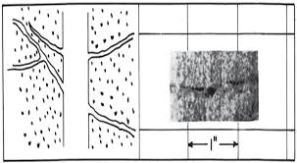
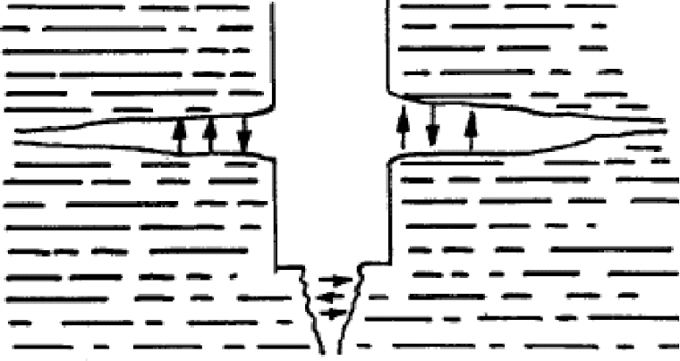
10
NATURAL or INTRINSIC FRACTURES

Slide 11
Acoustic, electrical, and optical wellbore images provide means of detecting and distinguishing natural fractures from induced fractures. The direct measurement of mud loss flow rates and the downhole annular pressure while drilling (APWD) can also be used as an indication of a fracture as well as the type of fracture (Majidi et al 2011). High resolution flow-meters can accurately measure the rate of fluid flow into and out of the wellbore. The characteristic response of the rate of losses can be used to interpret the fracture characteristics. A useful technique for identifying the type of lost circulating zone is the utilization of plot of variation of mud pit levels. shows a qualitative response of mud losses in terms of the mud pit level changes with time
11
The following causes of fluctuating mudtank levels during drilling have been provided by Dyke et al. (1995):
Downhole losses through matrix permeability
Downhole losses into induced and natural fractures
Volume change owing to temperature and pressure effects
Surfaces mud losses
Hole collapse and enlargement
Change in bottom hole lithology
summarizes some important identification features used to distinguish between natural and induced fractures.

Slide 12
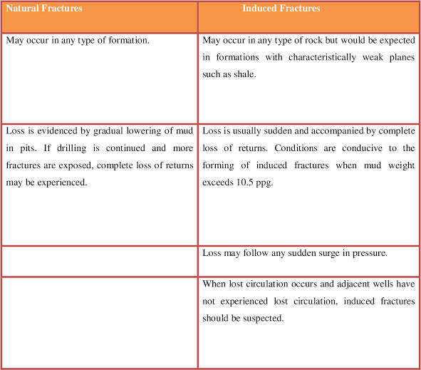
12

Slide 13
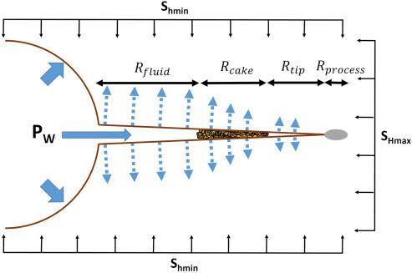
MECHANICS OF FRACTURING
Induced Fractures Normally Occur At The Weakest Part Of Formations. The Requirements For Forming Fractures Are Pressure And Surfaces Upon Which The Pressure May Act So That The Resultant Forces Are Of Sufficient Magnitude And Are Exerted In Such A Manner To Part The Formations (Howard And Scott, 1951). Depending Upon Depth, The Fractures Created Will Either Be Vertical Or Horizontal. If The Depth Is Around 2,500 Feet Or Less, Horizontal Pancake Fractures Are Usually Produced Because The Vertical Stress (Overburden) Is Lower Than The Horizontal Stresses. At Depths Greater Than 3,500 Feet, Vertical Fractures Are Created Because The Overburden Is Higher Than The Horizontal Stresses (Ramirez Et Al. 2005). Shows A Typical Stress Distribution In A Wellbore.
13
Where,
Pw = Wellbore Pressure;
Po = Pore Pressure;
Shmin = Minimum Horizontal Stress;
SHMAX = Maximum Horizontal Stress; and
įș = Effective Tangential (Hoop) Stress
The minimum horizontal stresses are inherent in a particular rock and cannot be altered while the effective tangential stresses are the near wellbore stresses acting on the periphery of the wellbore which are caused by drilling operations.

Slide 14
14
MANAGEMENT OF EQUIVALENT CIRCULATION DENSITY (ECD)
Drilling Programs Are Designed To Control Downhole Pressures In Order To Eliminate High Ecds That Lead To Induced Fractures. The Control Can Be Achieved Through Manipulating Mud Properties Such As Density, Viscosity, And Fluid Loss. The ECD Is The Measure Of The Combined Effect Of The Hydrostatic Pressure Of The Fluid In The Wellbore Plus The Created Friction Pressure While The Fluid Is Being Circulated (Metcalf Et Al. 2011):
ECD= Ptotal / (0.052×TVD) ………………………………………………………………………...
Where,
PTotal = Phydrostatic + Pfriction;
PTotal = Total Annular Pressure;
Phydrostatic = Hydrostatic Pressure;
Pfriction = Annular Friction Pressure; and
TVD = True Vertical Depth.
Equivalent Circulating Density (ECD) Is A Function Of The Following (Fidan Et Al. 2004):
Annular Space: The Smaller The Annular Area, The Greater The Ecds Will Be.
Fluid Rheology: Higher Viscosities Will Increase The Ecds.
Pump Rate: The Higher The Rate, The Higher The Ecds.
Apart From Manipulating Mud Properties To Controlling The Generation Of Excessive Ecds, Knowledge Of The Fracture Gradient In An Area Is An Important Step Towards Combating lost returns during drilling operations.

Slide 15
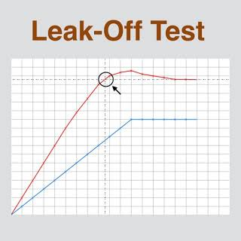
15
Individual Tests May Be Difficult To Interpret When No Clear Or Unique Deflection/Deviation Point Exists.
Test Data Is Often Recorded Manually At A Coarse Sampling Rate, Disallowing Raw Data Scrutiny.
Some Bias Towards Higher Interpretations May Even Be Introduced By The Drilling Team’s Eagerness To Drill Ahead.
Leak-off Pressures (Lops) From A Group Of Neighbouring Wells Are Often Scattered, Giving Considerable Room For Subjective Interpretation Of Local Trend.

Slide 16
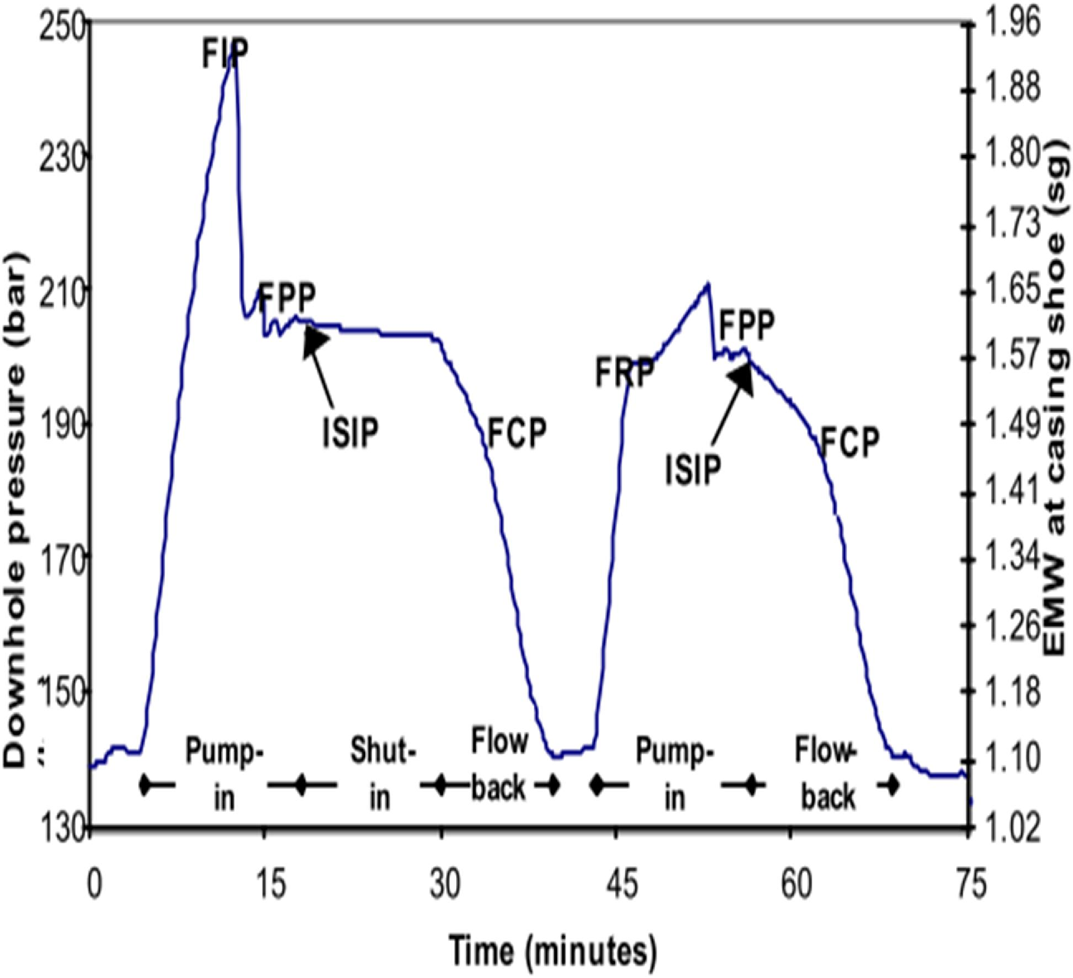
16
The Decision To Perform An XLOT At The Casing Shoe Should Take Into Account Both The Cost Of Breaking The Near-well Barrier And The Benefit Of Knowing What Stress And FPP Lies Behind That Barrier. The Near-well Barrier Is The Volume Of Rock Whose Stress State Is Affected By The Presence Of The Borehole, Usually 1-2 Hole Diameters Into The Formation. Shows An Example Of An XLOT From The Norne Field In Offshore Norway.
FIP: Fracture Initiation Pressure
FRP: Fracture Re-opening Pressure
FCP: Fracture Closure Pressure
ISIP: Initial Shut-in Pressure
FPP: Fracture Propagation Pressure

Slide 17
17
THANK
YOU

